Slide 1

Library Management System
Tu Trung Tin – 10421106
Nguyen Ngoc Hoang Nam – 10421042
Cao Thang Long - 10421089

Slide 2

TABLE OF CONTENTS
01
02
Introduction
Project Design
03
Conclusion
Give a brief intro about the project
Go through all the things in the project
Give a conclusion to the project

Slide 3

1. INTRODUCTION

Slide 4
2. Project Design
Database
Controller
GUI

Slide 5
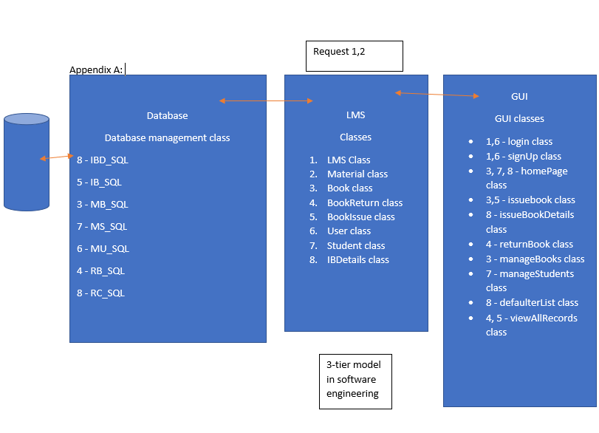
Appendix

Slide 6
Controller
Object
Class
OOP Techniques
Class Diagram
Books
Students
8 Classes 2 Abstract class
Overloading
Overriden
Inheritance

Slide 7
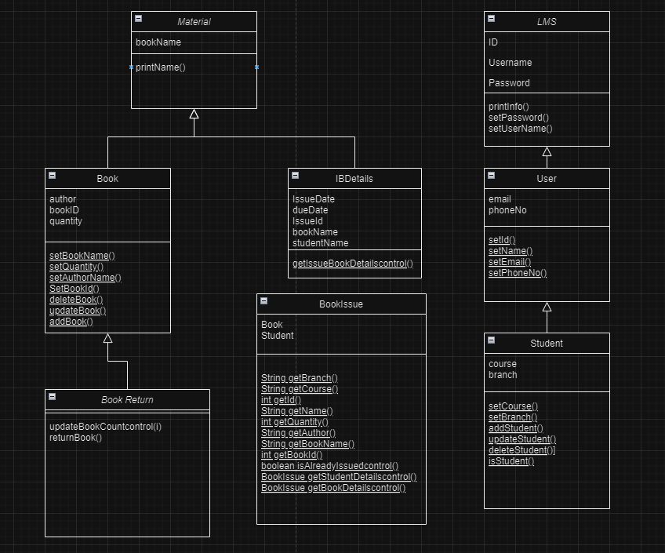
Class Diagram

Slide 8
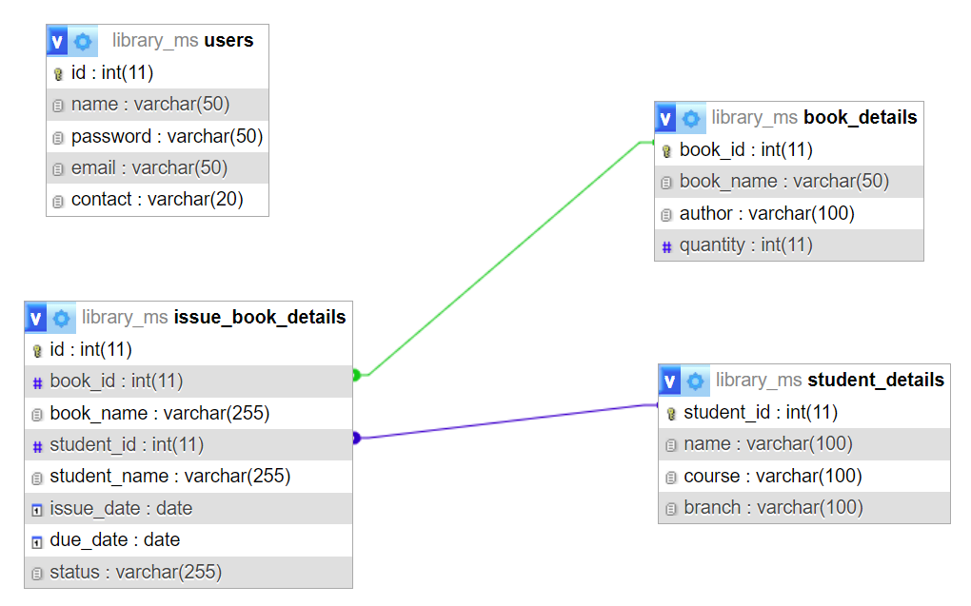
Database

Slide 9
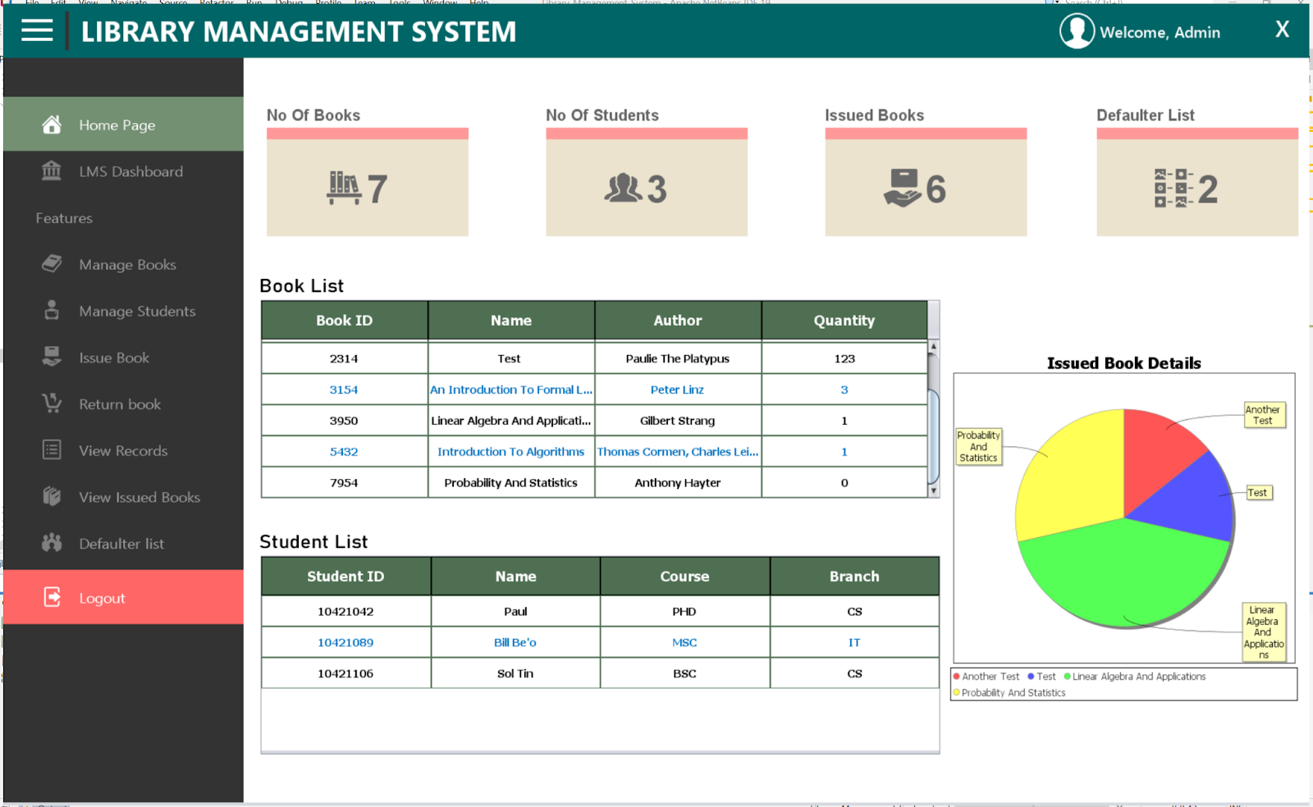
GUI

Slide 10
3. Conclusion

